Slide 1
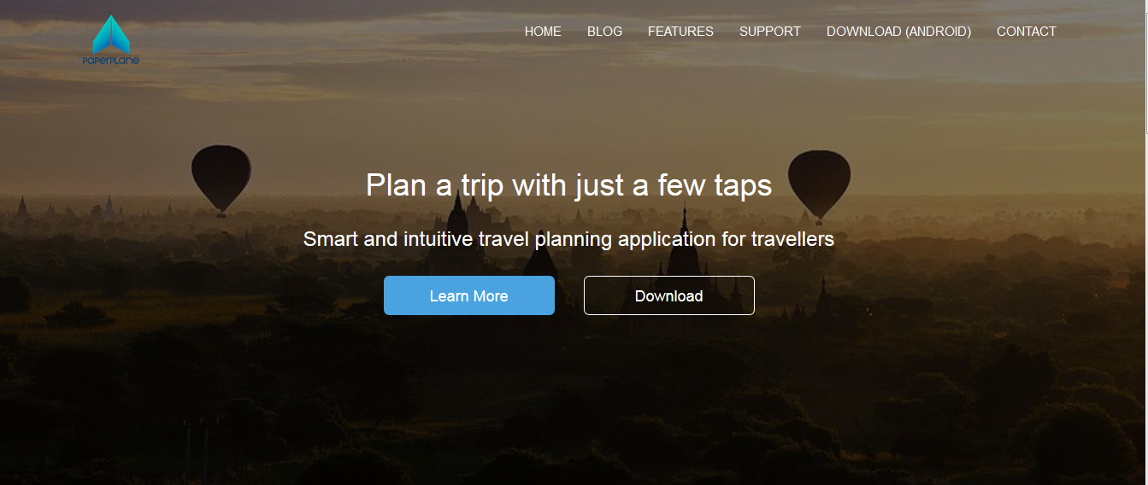
Paperplane Website

Slide 2
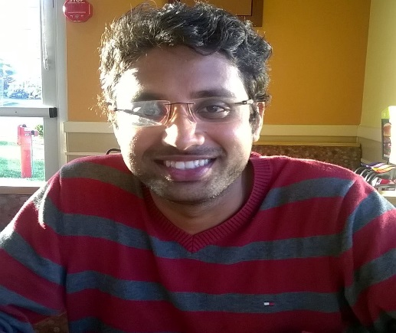


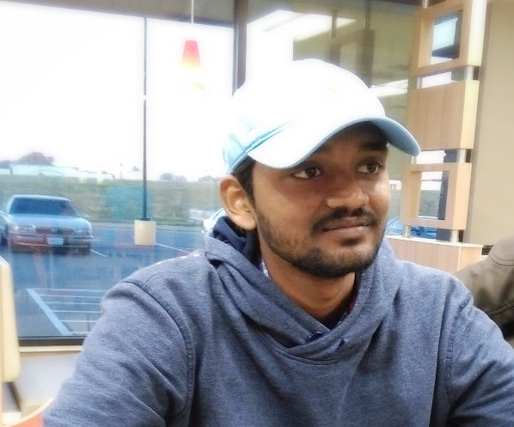
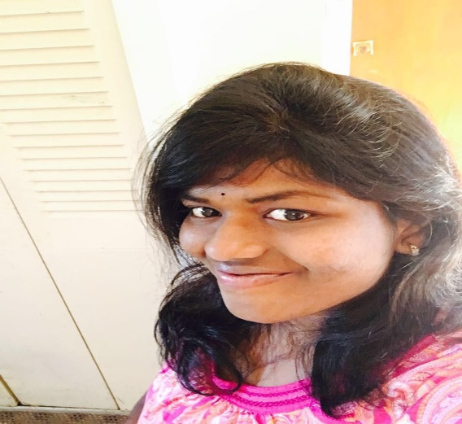

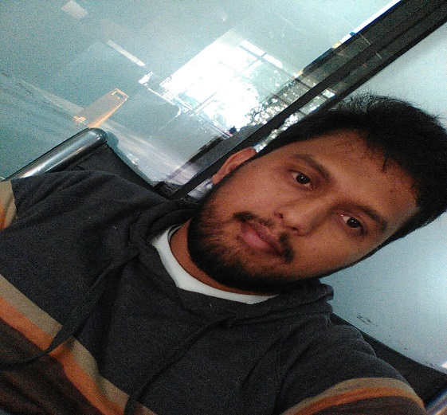
Techno Knights
Bhanu Teja Kurucheti
Sai Raj Kiran Kandula
Sai Sumanth Kattekola
Hima Teja Gutta
Sravya Madarapu
Vamshinath Nallamothu
Adarsh Kumar Reddy Pidaparthy

Slide 3
Team member responsibilities:
Primary Contact: Vamshinath Nallamothu
Client management: Bhanu Teja Kurucheti
Requirements management: Hima Teja Gutta
Data management: Sravya Madarapu
Issues management: Sai Sumanth Kattekola
Quality and testing management:Adarsh Kumar Reddy Pidaparthy
Communications and documentation management: Sai Raj Kiran Kandula

Slide 4
Agenda
Itinerary page with maps.
Settings page.

Slide 5
Tasks accomplished
Developed homepage with links to settings, login/sign up and contact us.
Itinerary plan can be generated based on destination.
Integrated Google maps API to generate itinerary plan along with Google maps and directions .
Validations for all user entry.
Developed User settings and travel settings functionalities.

Slide 6
Technology used
Technology Stack:
HTML 5
Bootstrap 3.3.6
Planned Integrated Development Environment:
Dreamweaver
Source code hosting site:
GitHub

Slide 7
Conclusion
We have worked on the core functionality of searching and viewing itinerary plan based on destination.
We would start working on API integration when it is deployed on the server.

